Slide 1
ONLINE CHILD SEXUAL EXPLOITATION
BY CHARLIE PORTER-BAKER

Slide 2
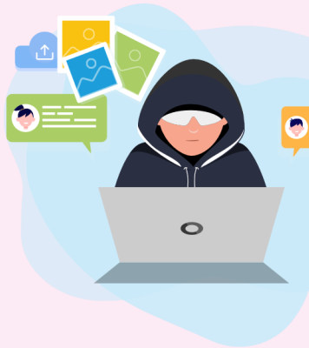
WHAT FORMS CAN ONLINE CSE TAKE?
Online Grooming.
Live Streaming.
Online Coercion and Blackmail.
Possession, Production and Sharing of Indecent Images of Children (IIDC) and Prohibited Images.
ACTIVITY - In groups of 5 match the definitions.

Slide 3
DEFINITIONS EXPLAINED
Online Grooming - The act of developing a relationship with a child to enable their abuse and exploitations both online and offline.
Live Streaming - Encouraging victims to commit or watch sexual acts via webcam. Also involves watching live contact sexual abuse with the offender directing what acts are perpetrated on the victim.
Online Coercion and Blackmail - Using sexual images and/or videos depicting that child, for the purposes of sexual gain, financial gain or other personal gain.
Possession, Production and Sharing of Indecent Images of Children (IIDC) and Prohibited Images. - The use of online platforms to store, share and produce indecent images of children.

Slide 4
KEY THREATS IN ONLINE CSE
Peer-to-peer (P2) networks and anonymised access like Darknet networks (e.g. Tor). These give opportunity to stronger networking possibilities with the anonymity, causing people to be more open about sharing their sexual interests.
Live streaming of child sexual abuse. Facilitated through technology, with one trend concerning the profit-driven abuse of children overseas, live in front of a camera.

Slide 5
TRUE OR FALSE?
Last year 2.88 million accounts were registered globally across the most harmful child sexual abuse dark websites.
In 2021, the Internet Watch Foundation (IWF) took action against 160,398 URLs containing images or videos of ‘self-generated’ material - a 70% increase on pre-pandemic levels. In 2019, the number of URLs removed was 38,424.
Young boys are at particular risk, 10 years ago they accounted for 60% of the children seen in sexual abuse images - that has now risen to 97%.
Self generated imagery of children between the ages of 7-10 is the fastest type of material being seen.

Slide 6
TRUE OR FALSE ANSWERS
TRUE - Last year 2.88 million accounts were registered globally across the most harmful child sexual abuse dark websites.
FALSE - In 2021, the Internet Watch Foundation (IWF) took action against 182,281 URLs containing images or videos of ‘self-generated’ material - a 374% increase on pre-pandemic levels. In 2019, the number of URLs removed was 38,424.
FALSE - Young girls are at particular risk, 10 years ago they accounted for 60% of the children seen in sexual abuse images - that has now risen to 97%.
TRUE - Self generated imagery of children between the ages of 7-10 is the fastest type of material being seen.

Slide 7
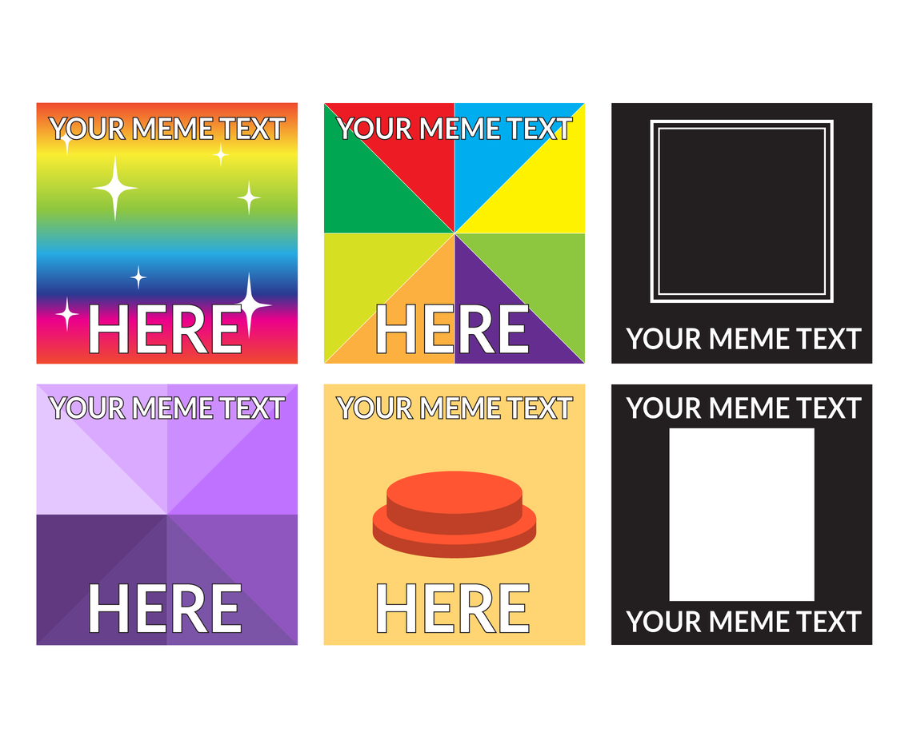
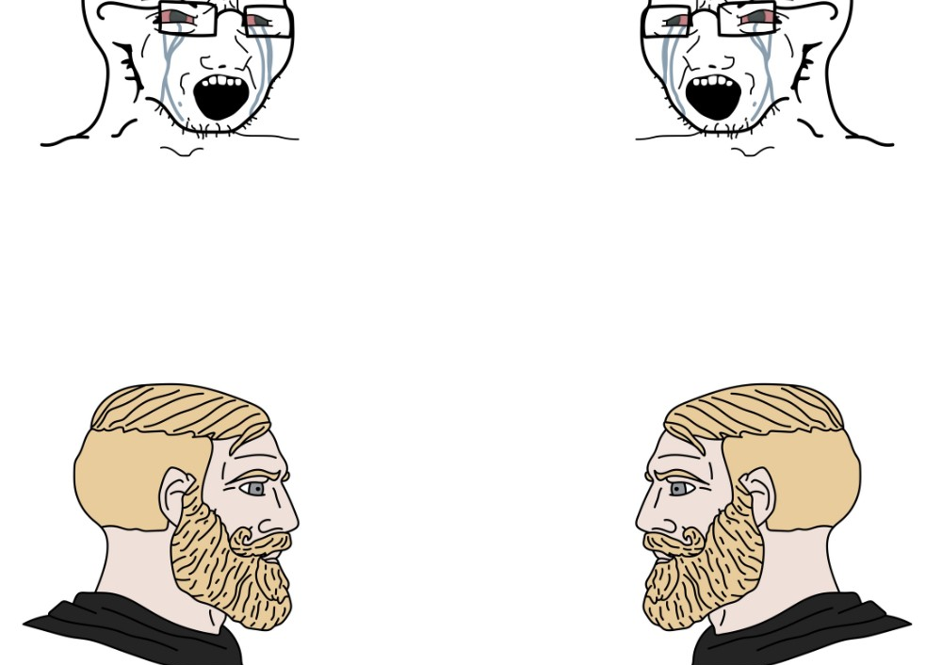
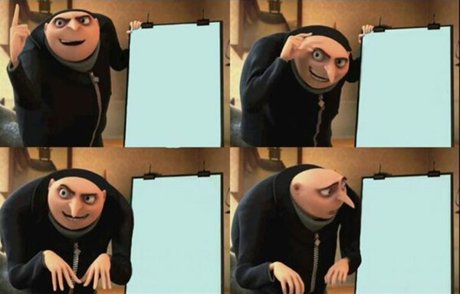
MEME LAYOUT EXAMPLES

Slide 8
MEME EXERCISE - TO BE MADE ON POWERPOINT/CANVA
In national countries create 3 meme’s looking at any of the following (aimed at young people):
Raising awareness of CSE generally.
Raising awareness of online CSE.
What support is available (in your country) - could be a specific organisation.
What are the signs of online CSE.

